Slide 1
USING RETENTION TIME TO IDENTIFY PEPTIDES
Max Quant, retention time library
Percolator, mq.to.pin parser
[25.Apr.2017]

Slide 2

Validation of search results
Max Quant:
Andromeda Score, Peptide length, … → Target/Decoy → PEP
PEP + dRT:
PSM is correct if it’s observed RT is close to expected RT of the peptide.
Percolator:
SVM → q-Value/PEP
Peptide-Prophet:
Discriminant Score → Target/Decoy → Peptide-Prophet probability
$$PEP=\frac{b}{a+b}$$

Slide 3
Goal
We would like to collect RTs of the same peptides from multiple experiments and store them in a library to use them later for identification.
The elution time of the peptides from one analysis is generally distorted or shifted in comparison to the RT for the same peptides in another analysis.
This distortion can be more significant when a different chromatographic column is used for each analysis, but can often be observed between analyses on the same column as a result of variations in flow rate and temperature, differences in the packing of the chromatographic columns, etc.
This can be addressed either by using software algorithms to compensate for the shifts or by improving the reproducibility of the LC system itself since some sources of error cannot be corrected subsequently. [1]
Problem
Solution
[1] Zimmer, Jennifer SD, et al. "Advances in proteomics data analysis and display using an accurate mass and time tag approach." Mass spectrometry reviews 25.3 (2006): 450-482.

Slide 4
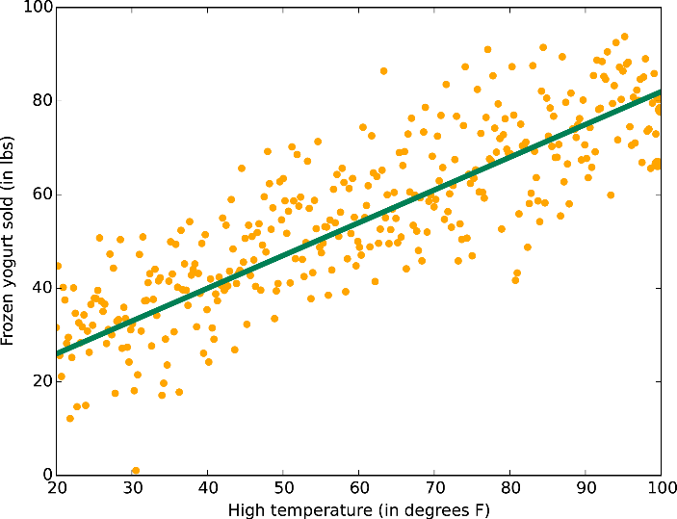
exp 1
1. (a, b): Robust regression between the intersection of ref.exp and exp.i (PEP<5e-3).
exp 2
ref.exp
PEP<5e-3
exp.i
PEP<5e-3
2. exp.i’s RTs (PEP<0.05) are updated using the regression coefficients and then added to the library.
exp.i RTs
ref.exp
exp.i
ref.exp RTs
3. ref.exp is selected by an algorithm.
(a, b)
4. Library is post processed to remove the outliers.
exp.i
PEP<0.05
exp 4
experiment | intercept | coeff
160629AEL160624PMRSAM00092_18B1 | 7.3282398 | 0.70261
160629AEL160624PMRSAM00092_18A2 | 9.4028570 | 0.71175
160629AEL160624PMRSAM00092_18A1 | 10.131797 | 0.70780
. | . | .
exp 5
LIBRARY
peptides | X 1 | X 2 | X 3 | X 4 | … | rt.mean | rt.median | rt.count
AAALQAK | 50 | NA | 51 | 52 | … | 51 | 51 | 3
AAAKPK | NA | 105 | 110 | 108 | … | 107.67 | 108 | 3
. | . | . | . | . | . | . | . | .

Slide 5
Increasing number of peptides and accuracy of the library by combining the search results from Comet and Max Quant:
We want a large, accurate library of peptides’ retention times …
 | No. peptides | No. experiments | Ave. no. RTs per pep. | Ave. no. RTs per pep. for overlap
Library v. 1: MQ | 23,578 | 137 | 9.61 | 9.61
Library v. 2: MQ + Comet | 27,281 | 149 | 10.86 | 12.24
evidence.txt | PEP < 0.02 | PEP < 0.05
No. peptides | 15,249 | 25,039

Slide 6
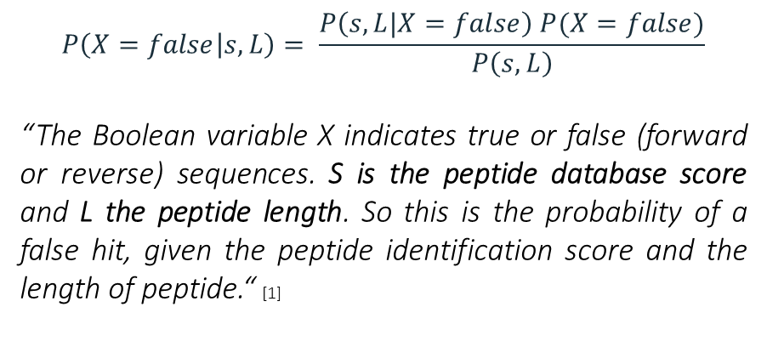
PEP in Max Quant
$$P\left(X=false | s, L\right)= \frac{P\left(s,L|X=false\right) P(X=false)}{P\left(s,L\right)}$$
“The Boolean variable X indicates true or false (forward or reverse) sequences. S is the peptide database score and L the peptide length. So this is the probability of a false hit, given the peptide identification score and the length of peptide.“ [1]
“Within the target-decoy strategy we use the concept of posterior error probability (PEP) to integrate multiple peptide properties, such as length, charge and number of modifications, together with the Andromeda score into a single quantity reflecting the quality of a PSM. This serves purpose similar to alternative machine learning algorithms. (Percolator)“ [2]
[1] Cox, Jürgen, and Matthias Mann. "MaxQuant enables high peptide identification rates, individualized ppb-range mass accuracies and proteome-wide protein quantification." Nature biotechnology 26.12 (2008): 1367-1372.
[2] Tyanova, Stefka, Tikira Temu, and Juergen Cox. "The MaxQuant computational platform for mass spectrometry-based shotgun proteomics." Nature Protocols 11.12 (2016): 2301-2319.

Slide 7
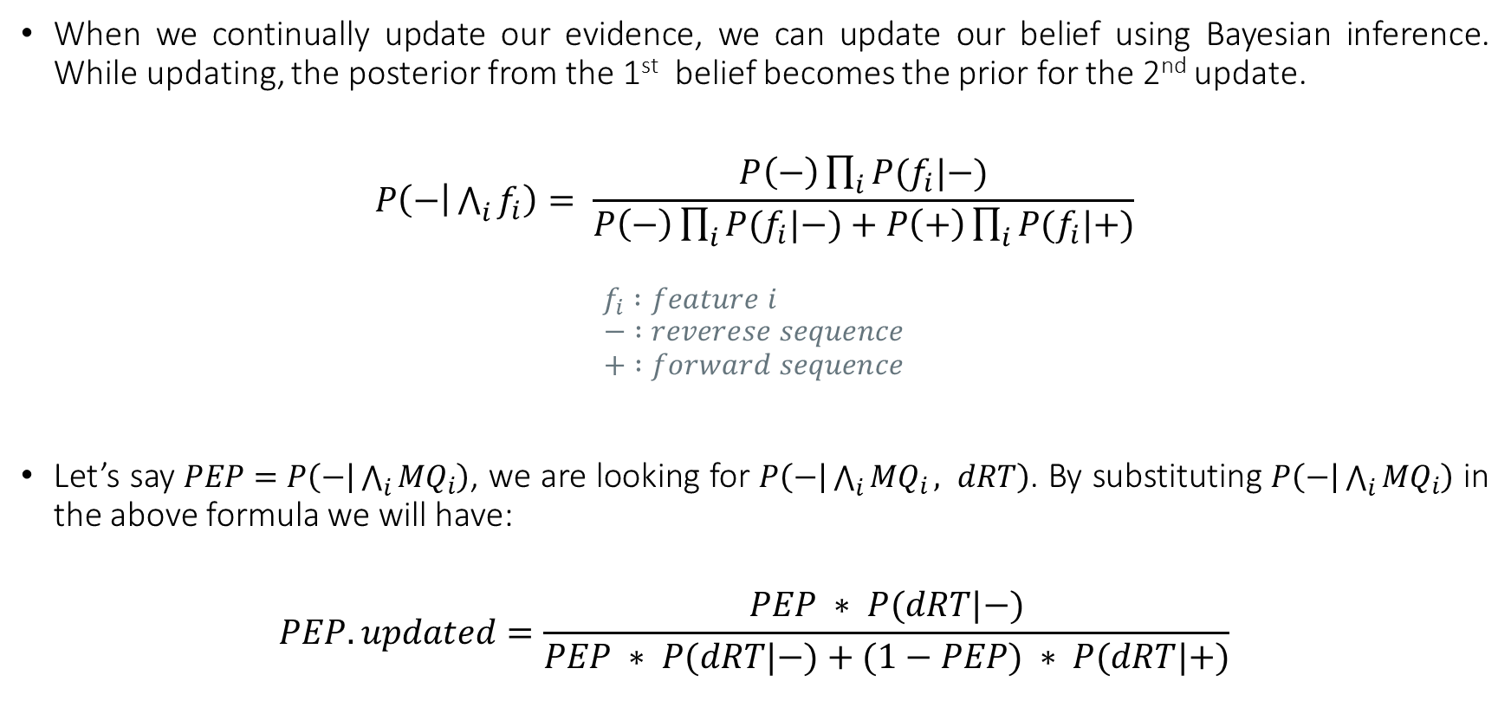
Bayesian updating with multiple pieces of evidence
When we continually update our evidence, we can update our belief using Bayesian inference. While updating, the posterior from the 1st belief becomes the prior for the 2nd update.
$$P\left(− | \bigwedge_{i}{f_{i}}\right)= \frac{P\left(−\right)\prod_{i}{P(f_{i}|−)}}{P\left(−\right)\prod_{i}{P(f_{i}|−)}+P\left(+\right)\prod_{i}{P(f_{i}|+)}}$$
$$f_{i} :feature i$$
$$− :reverese sequence$$
$$+ :forward sequence$$
Let’s say $PEP=P\left(− | \bigwedge_{i}{{MQ}_{i}}\right)$, we are looking for $P\left(− | \bigwedge_{i}{{MQ}_{i}}, dRT\right)$. By substituting $P\left(− | \bigwedge_{i}{{MQ}_{i}}\right)$ in the above formula we will have:
$$PEP. updated=\frac{PEP ∗ P(dRT|−)}{PEP ∗ P(dRT|−)+(1−PEP) ∗ P(dRT|+)}$$

Slide 8
Max Quant’s results in Percolator: mq.to.pin parser
Features:
dM
PEP
Peptide Length
Mass
m/z
Score
dScore
Charge
Number of matches
Is the peptide preceded by a tryptic site?
Does the peptide have a tryptic C-terminus?
Number of missed tryptic sites
Number of PSMs for which this is the best scoring peptide
Number of times the matched protein matches other PSMs
Number of different peptides that match this protein
dRT = | RT.observed – RT.library |
Percolator’s RT calculator

Slide 10
Max Quant vs. Percolator vs. dRT vs. Comet (pepPro)

Slide 11
Comparing the quantifications of the newly identified peptides with the previous quantifications.
Verification

Slide 12




protein i
only proteins with at least 2 new peptides
experiment i
Only experiments with different cell types in 2 channels
Peptides | Reporter intensity 0 | Reporter intensity 1
pep. 1 | . | .
pep. 2 | . | .
… | . | .
new pep. 1 | . | .
new pep. 2 | . | .
… | . | .
Proteins | R.old | R.new
prot. 1 | . | .
prot. 2 | . | .
… | . | .
R.g1 | R.g2 | Proteins
. | . | prot. 1
. | . | prot. 2
. | . | …
Group 1
PEP < 0.02
Group 2
PEP.updated < 0.02
cor (MQ, dRT)
cor (MQ, MQ)
$$R.old=mean\left(\frac{reporter intensity 0 (i)}{reporter intensity 1 (i)} | PEP<0.02\right)$$
$$R.new=mean\left(\frac{reporter intensity 0 (i)}{reporter intensity 1 (i)} | PEP.updated<0.02\right)$$
$$R.g1=mean\left(\frac{reporter intensity 0 (i)}{reporter intensity 1 (i)} | PEP <0.02\right)$$
$$R.g2=mean\left(\frac{reporter intensity 0 (i)}{reporter intensity 1 (i)} | PEP <0.02\right)$$

Slide 13
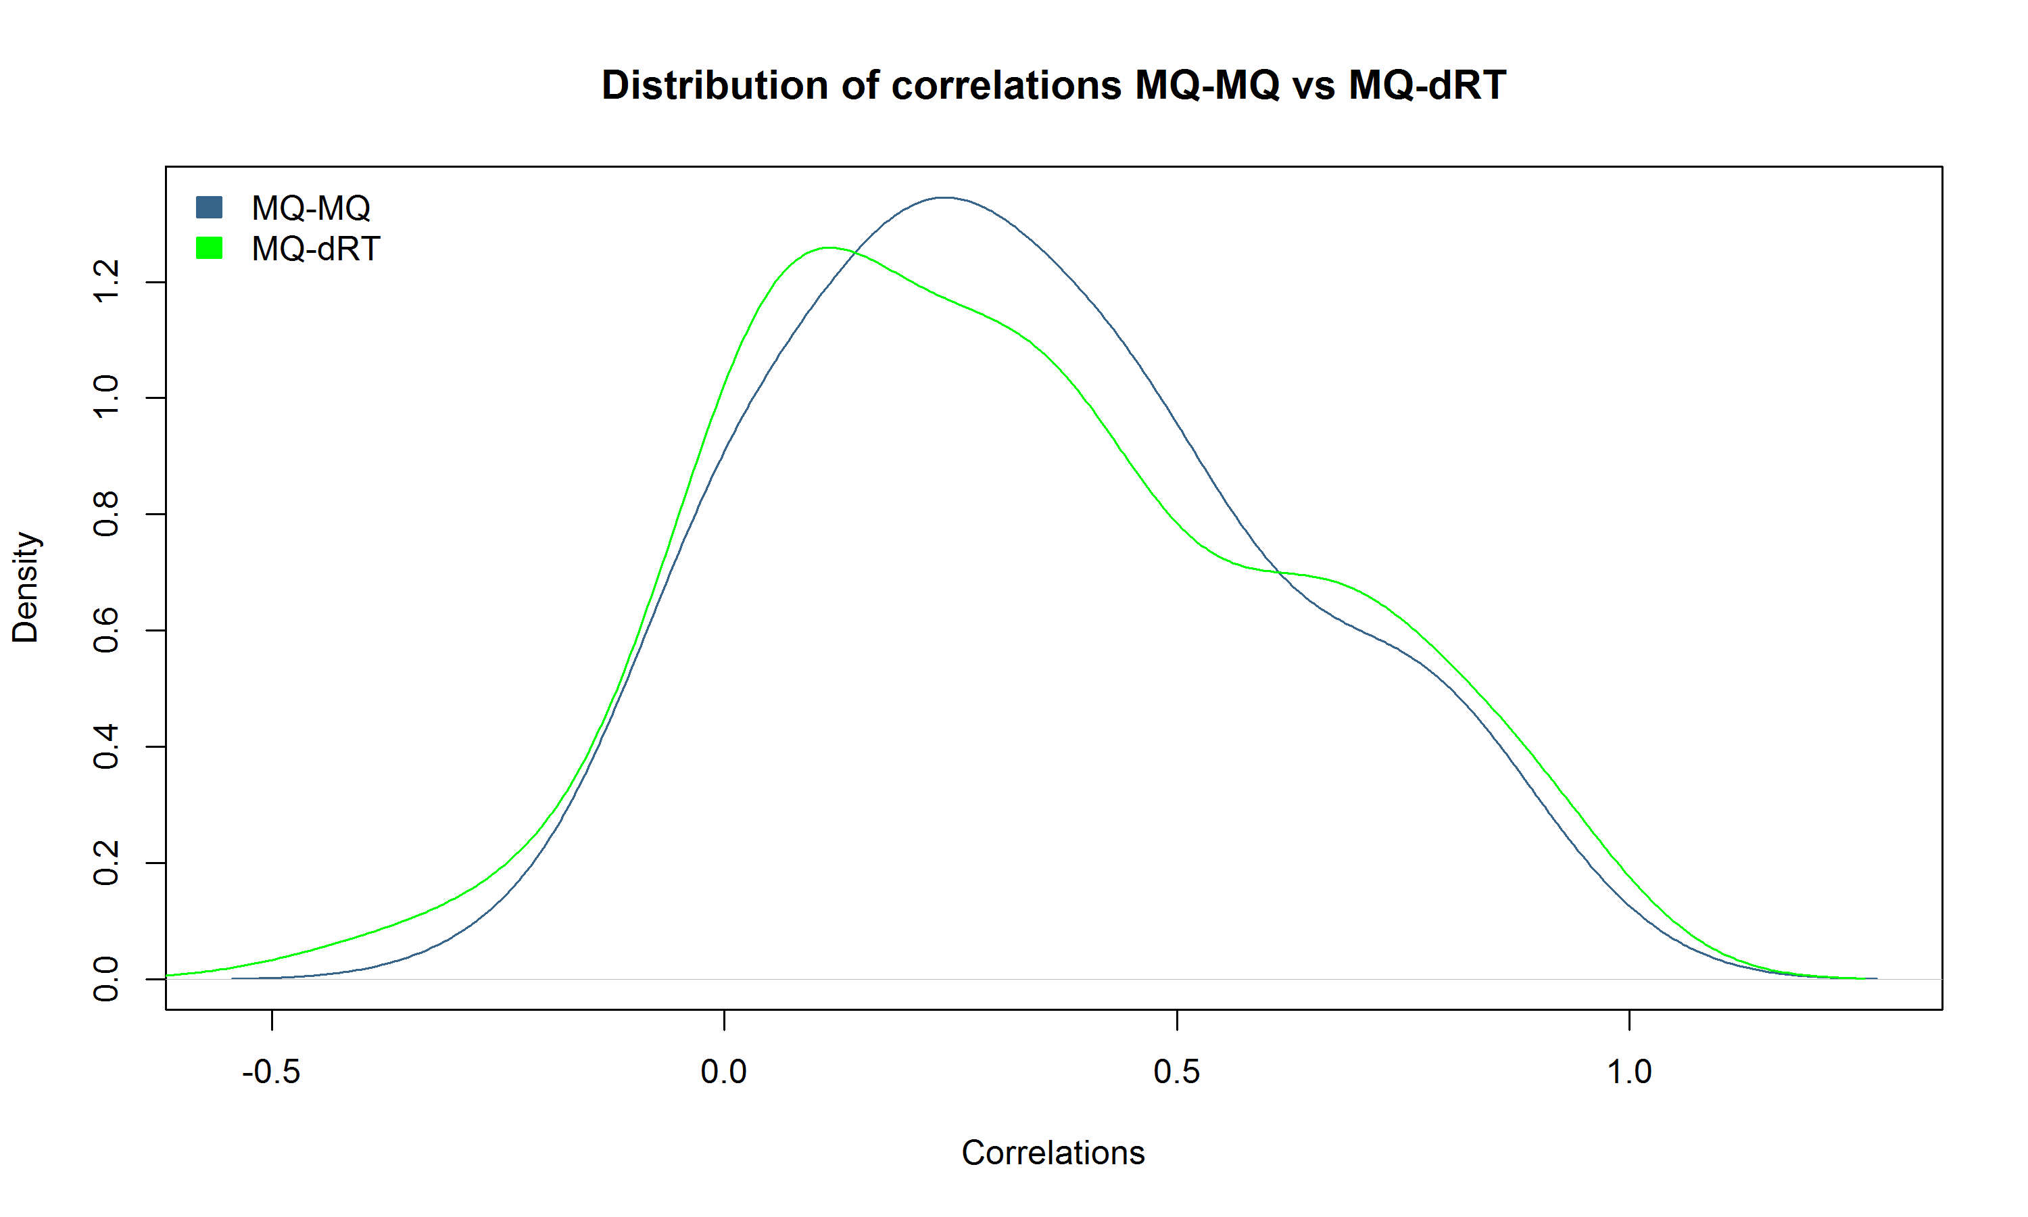
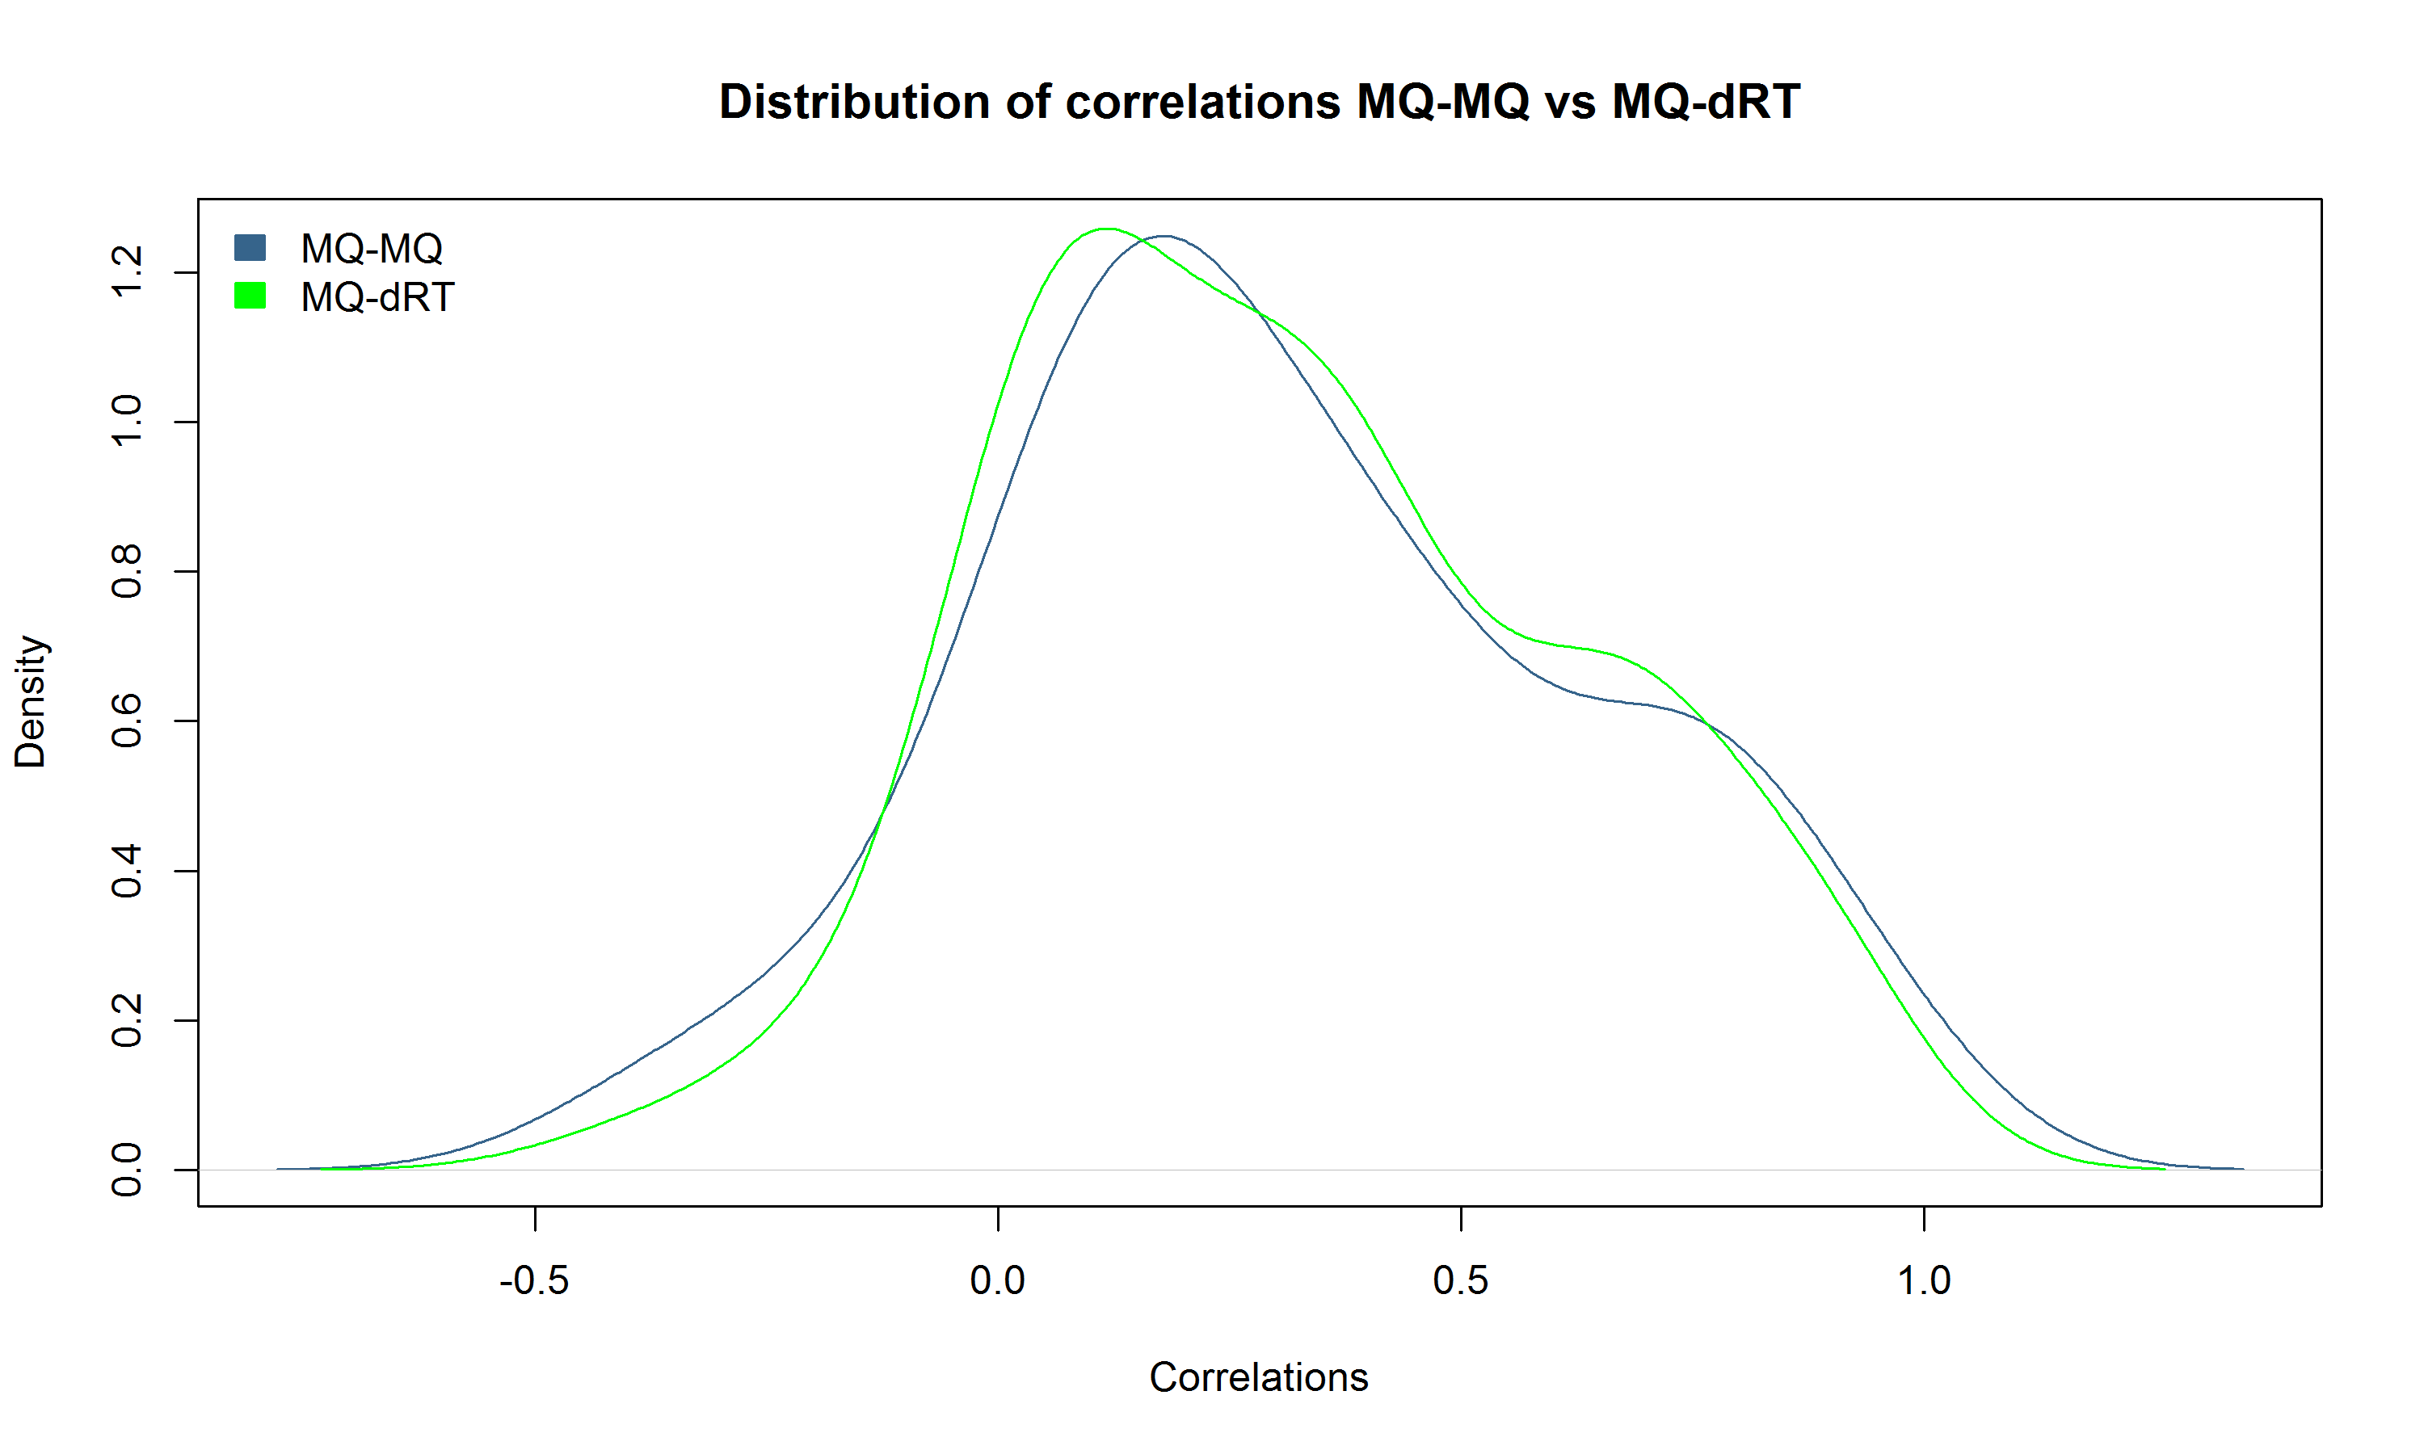
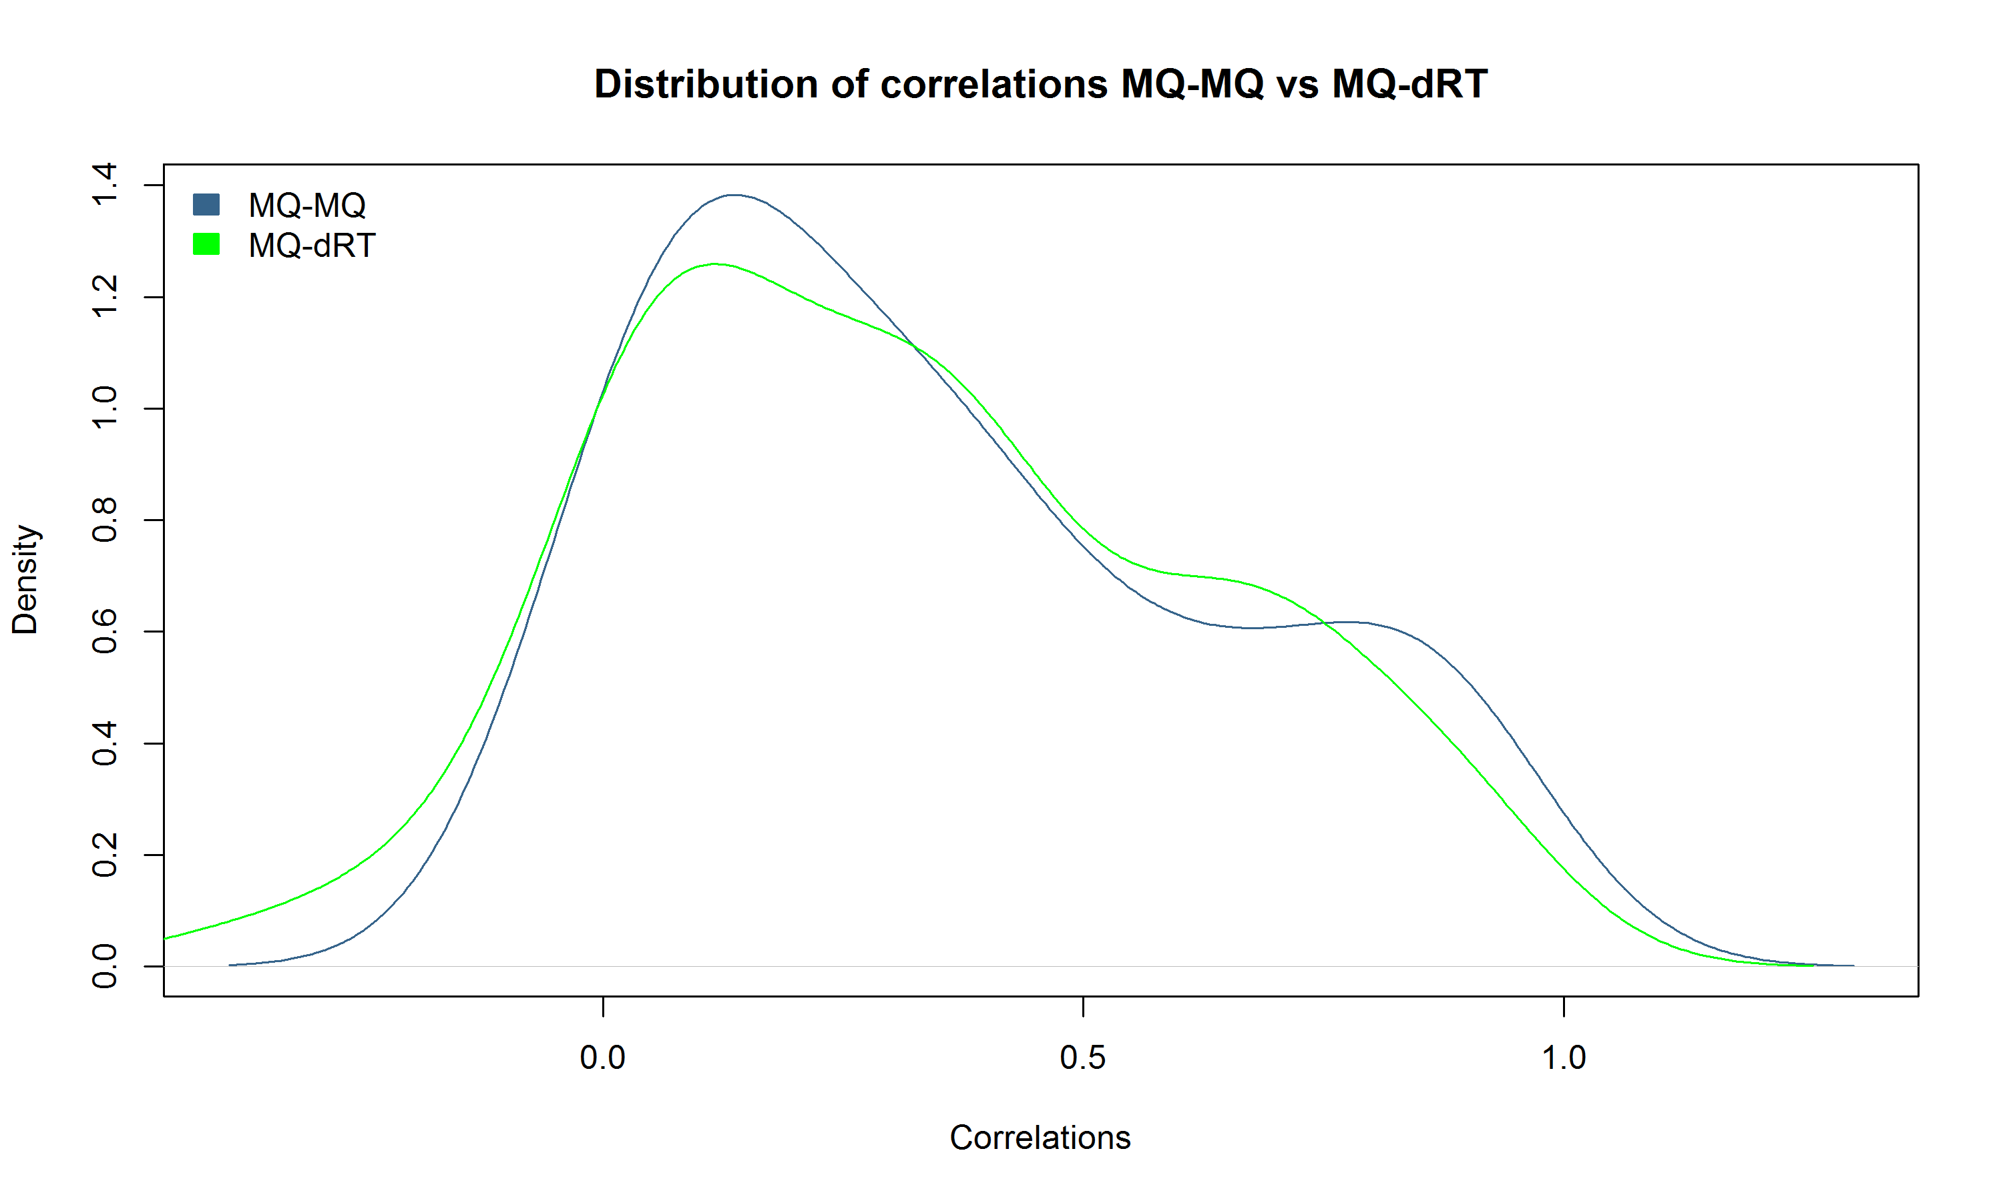
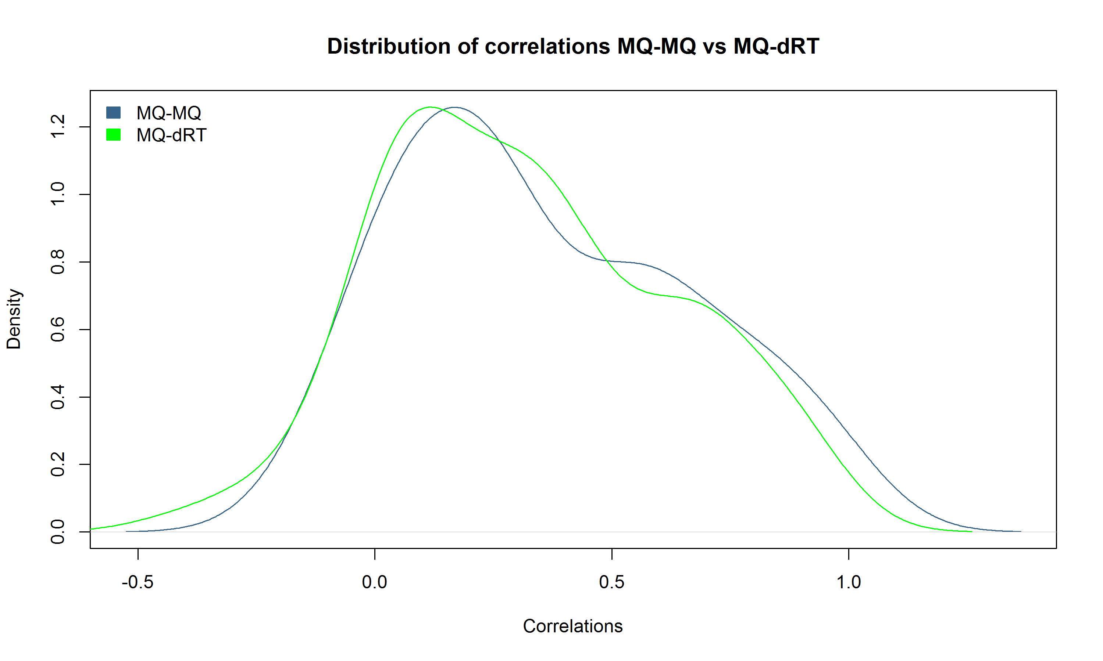
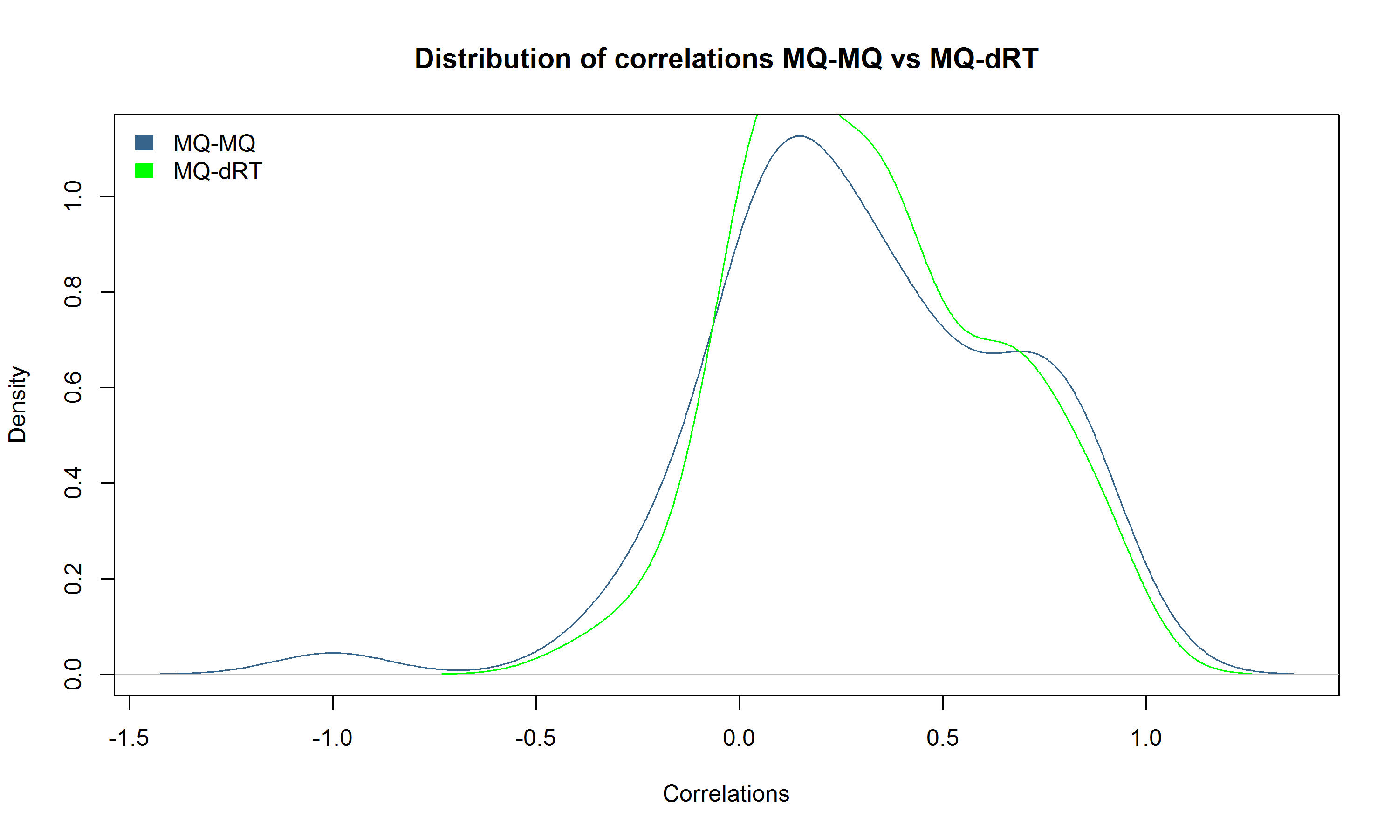

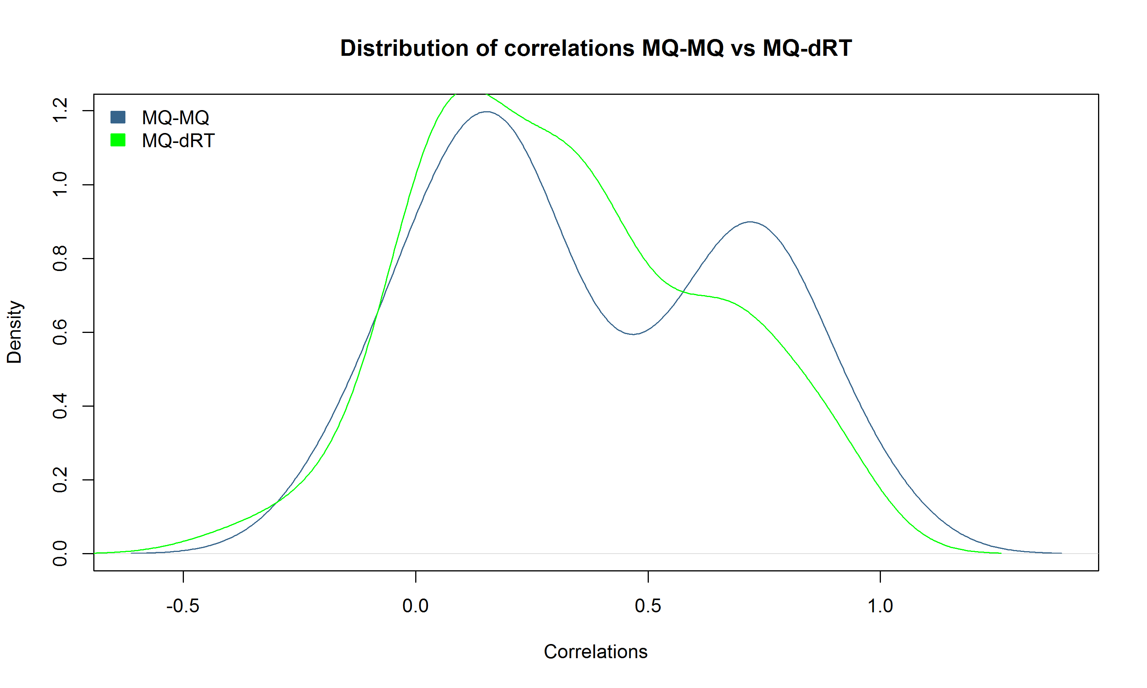
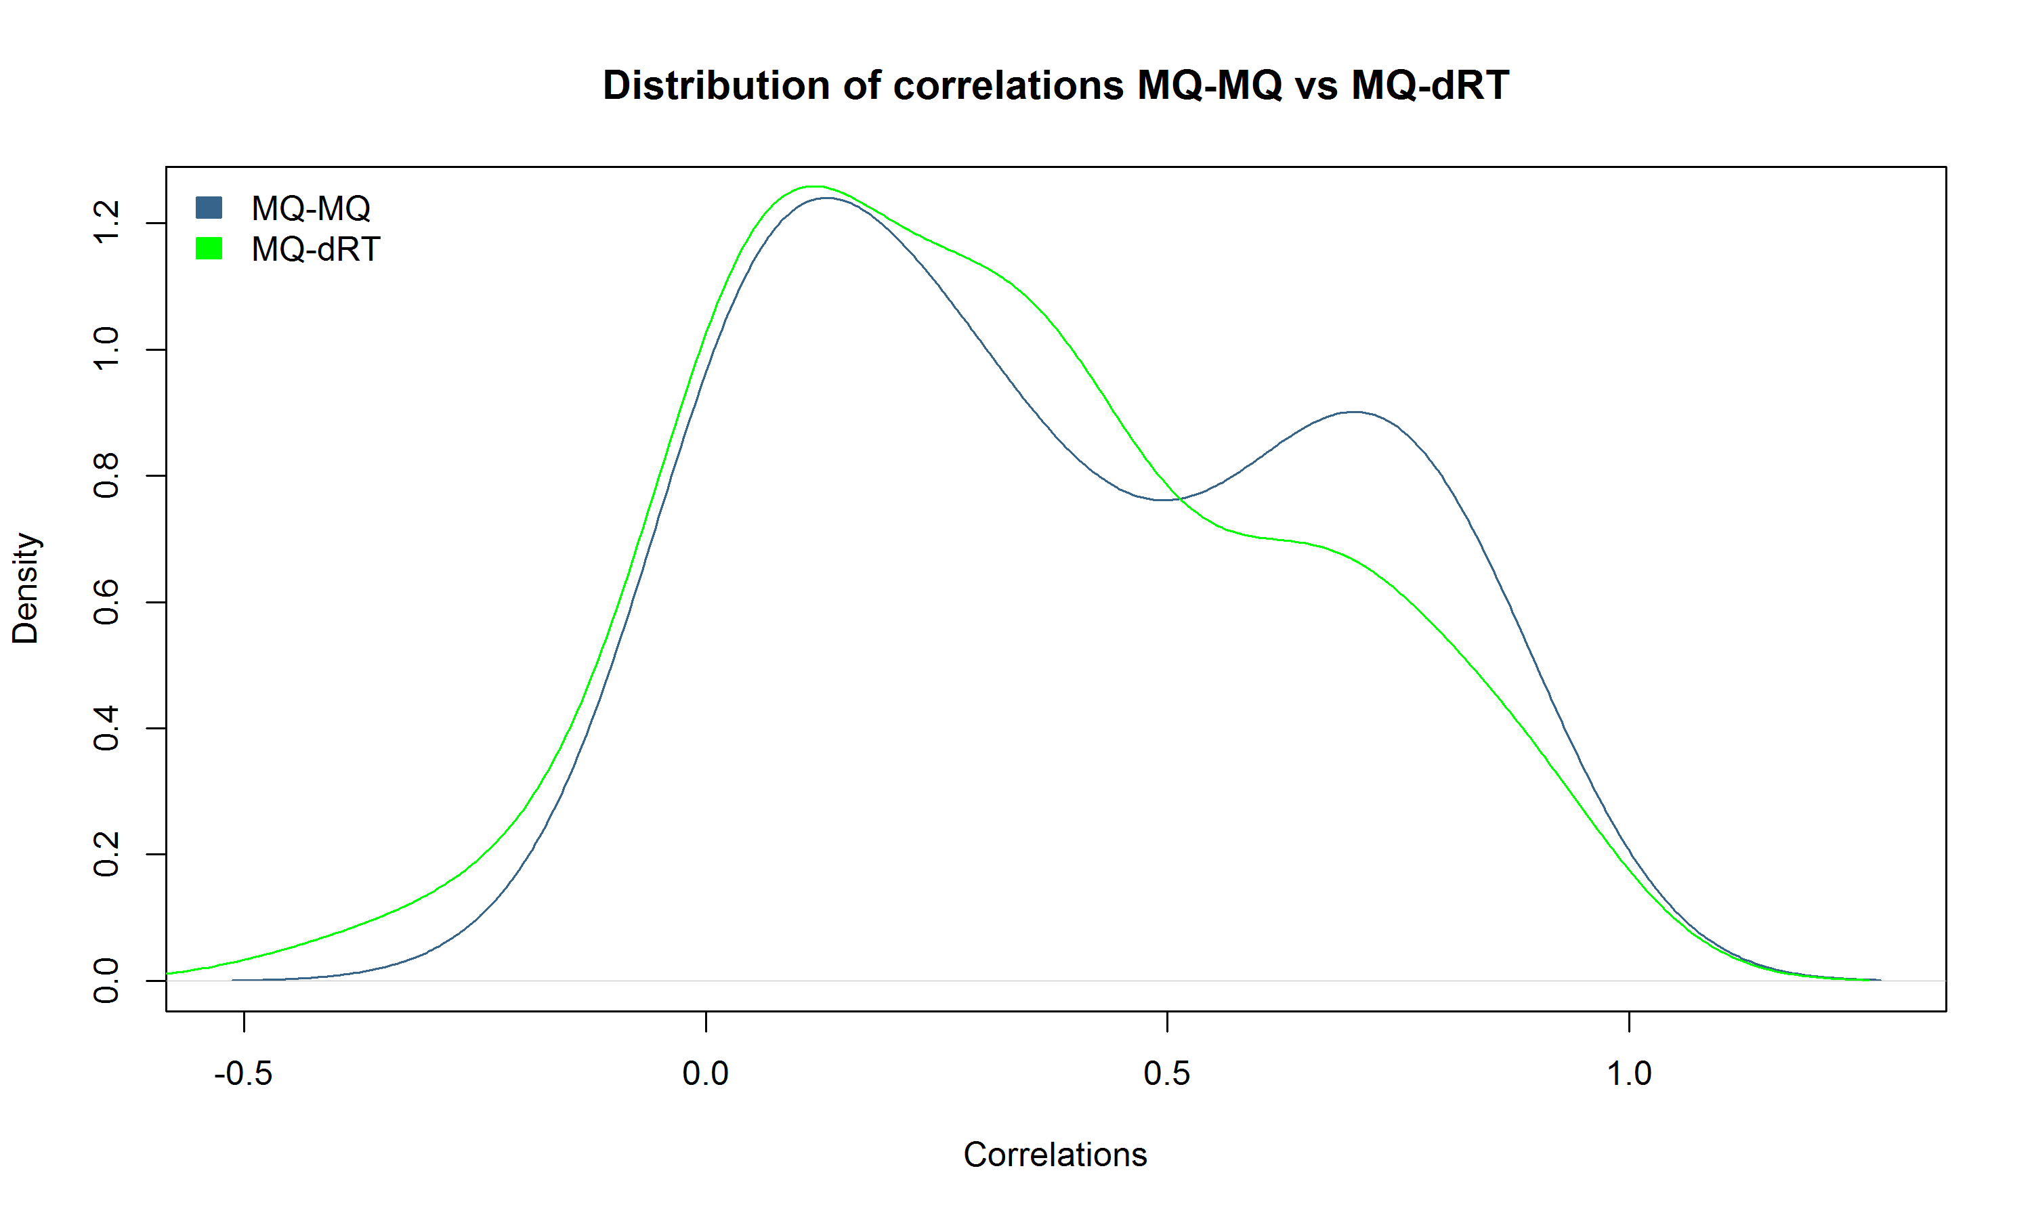
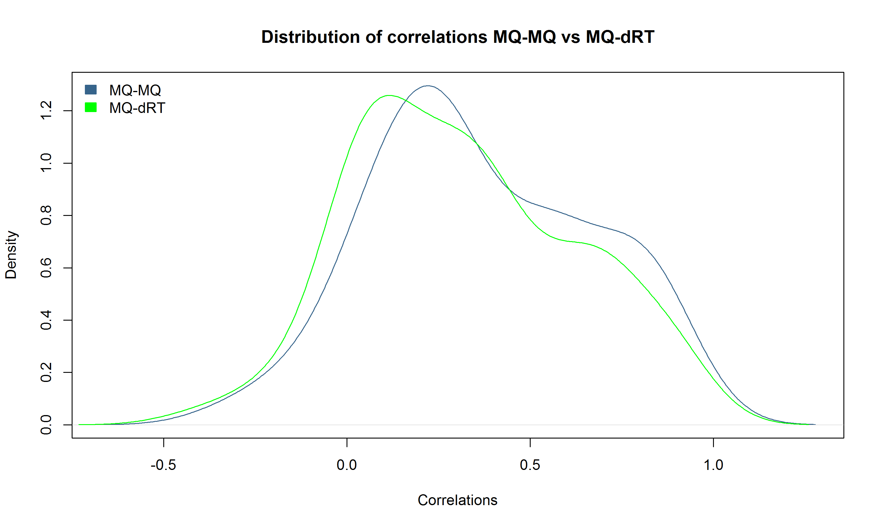
129 N
129 C

Slide 14
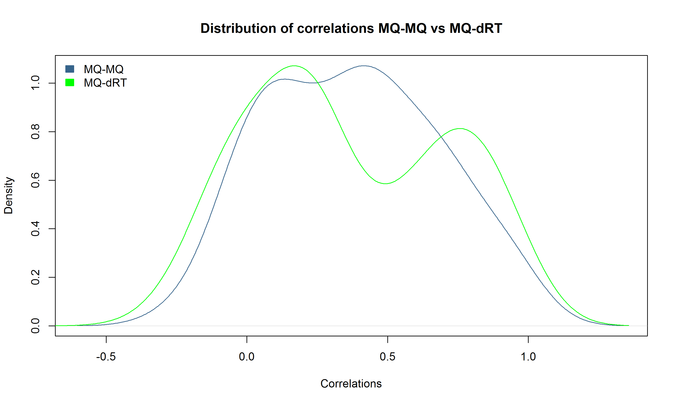
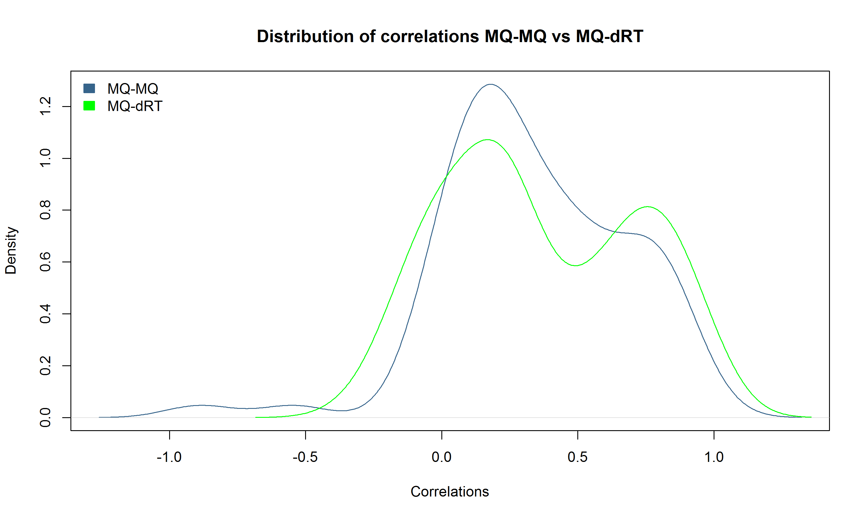
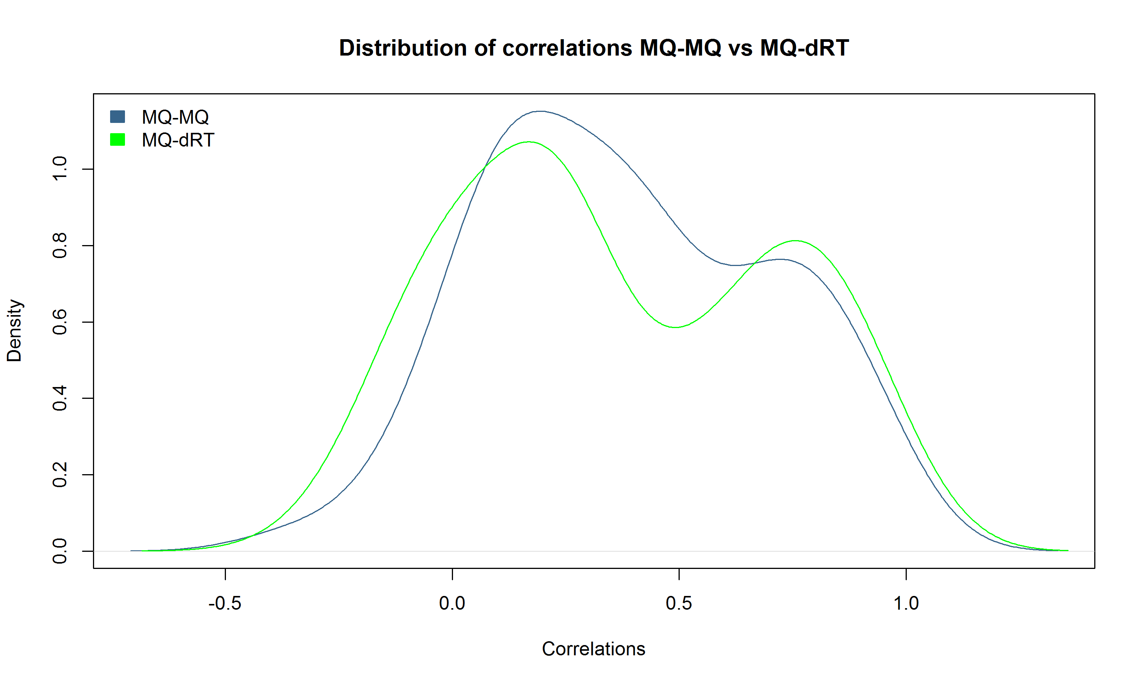
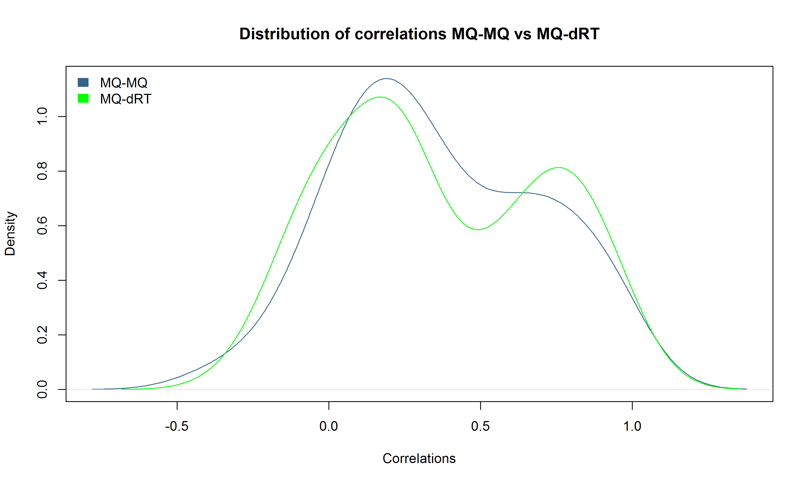

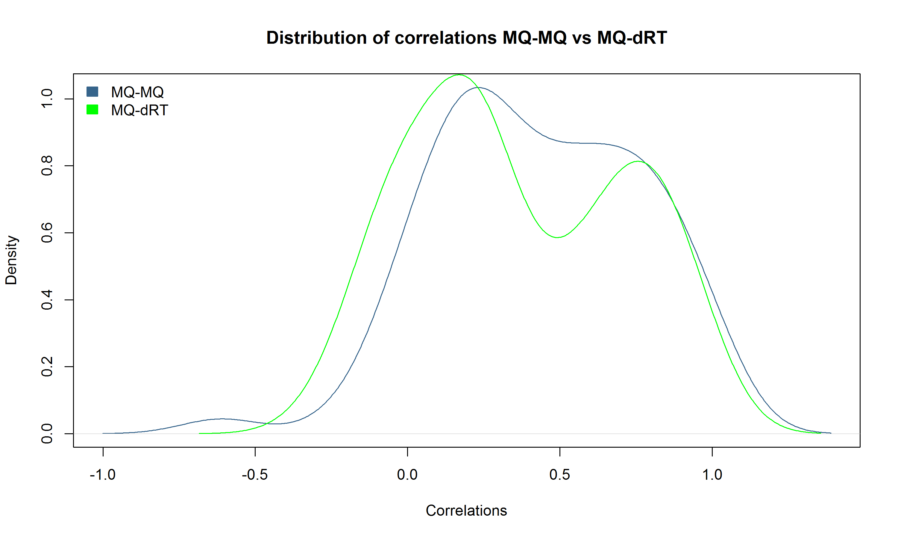
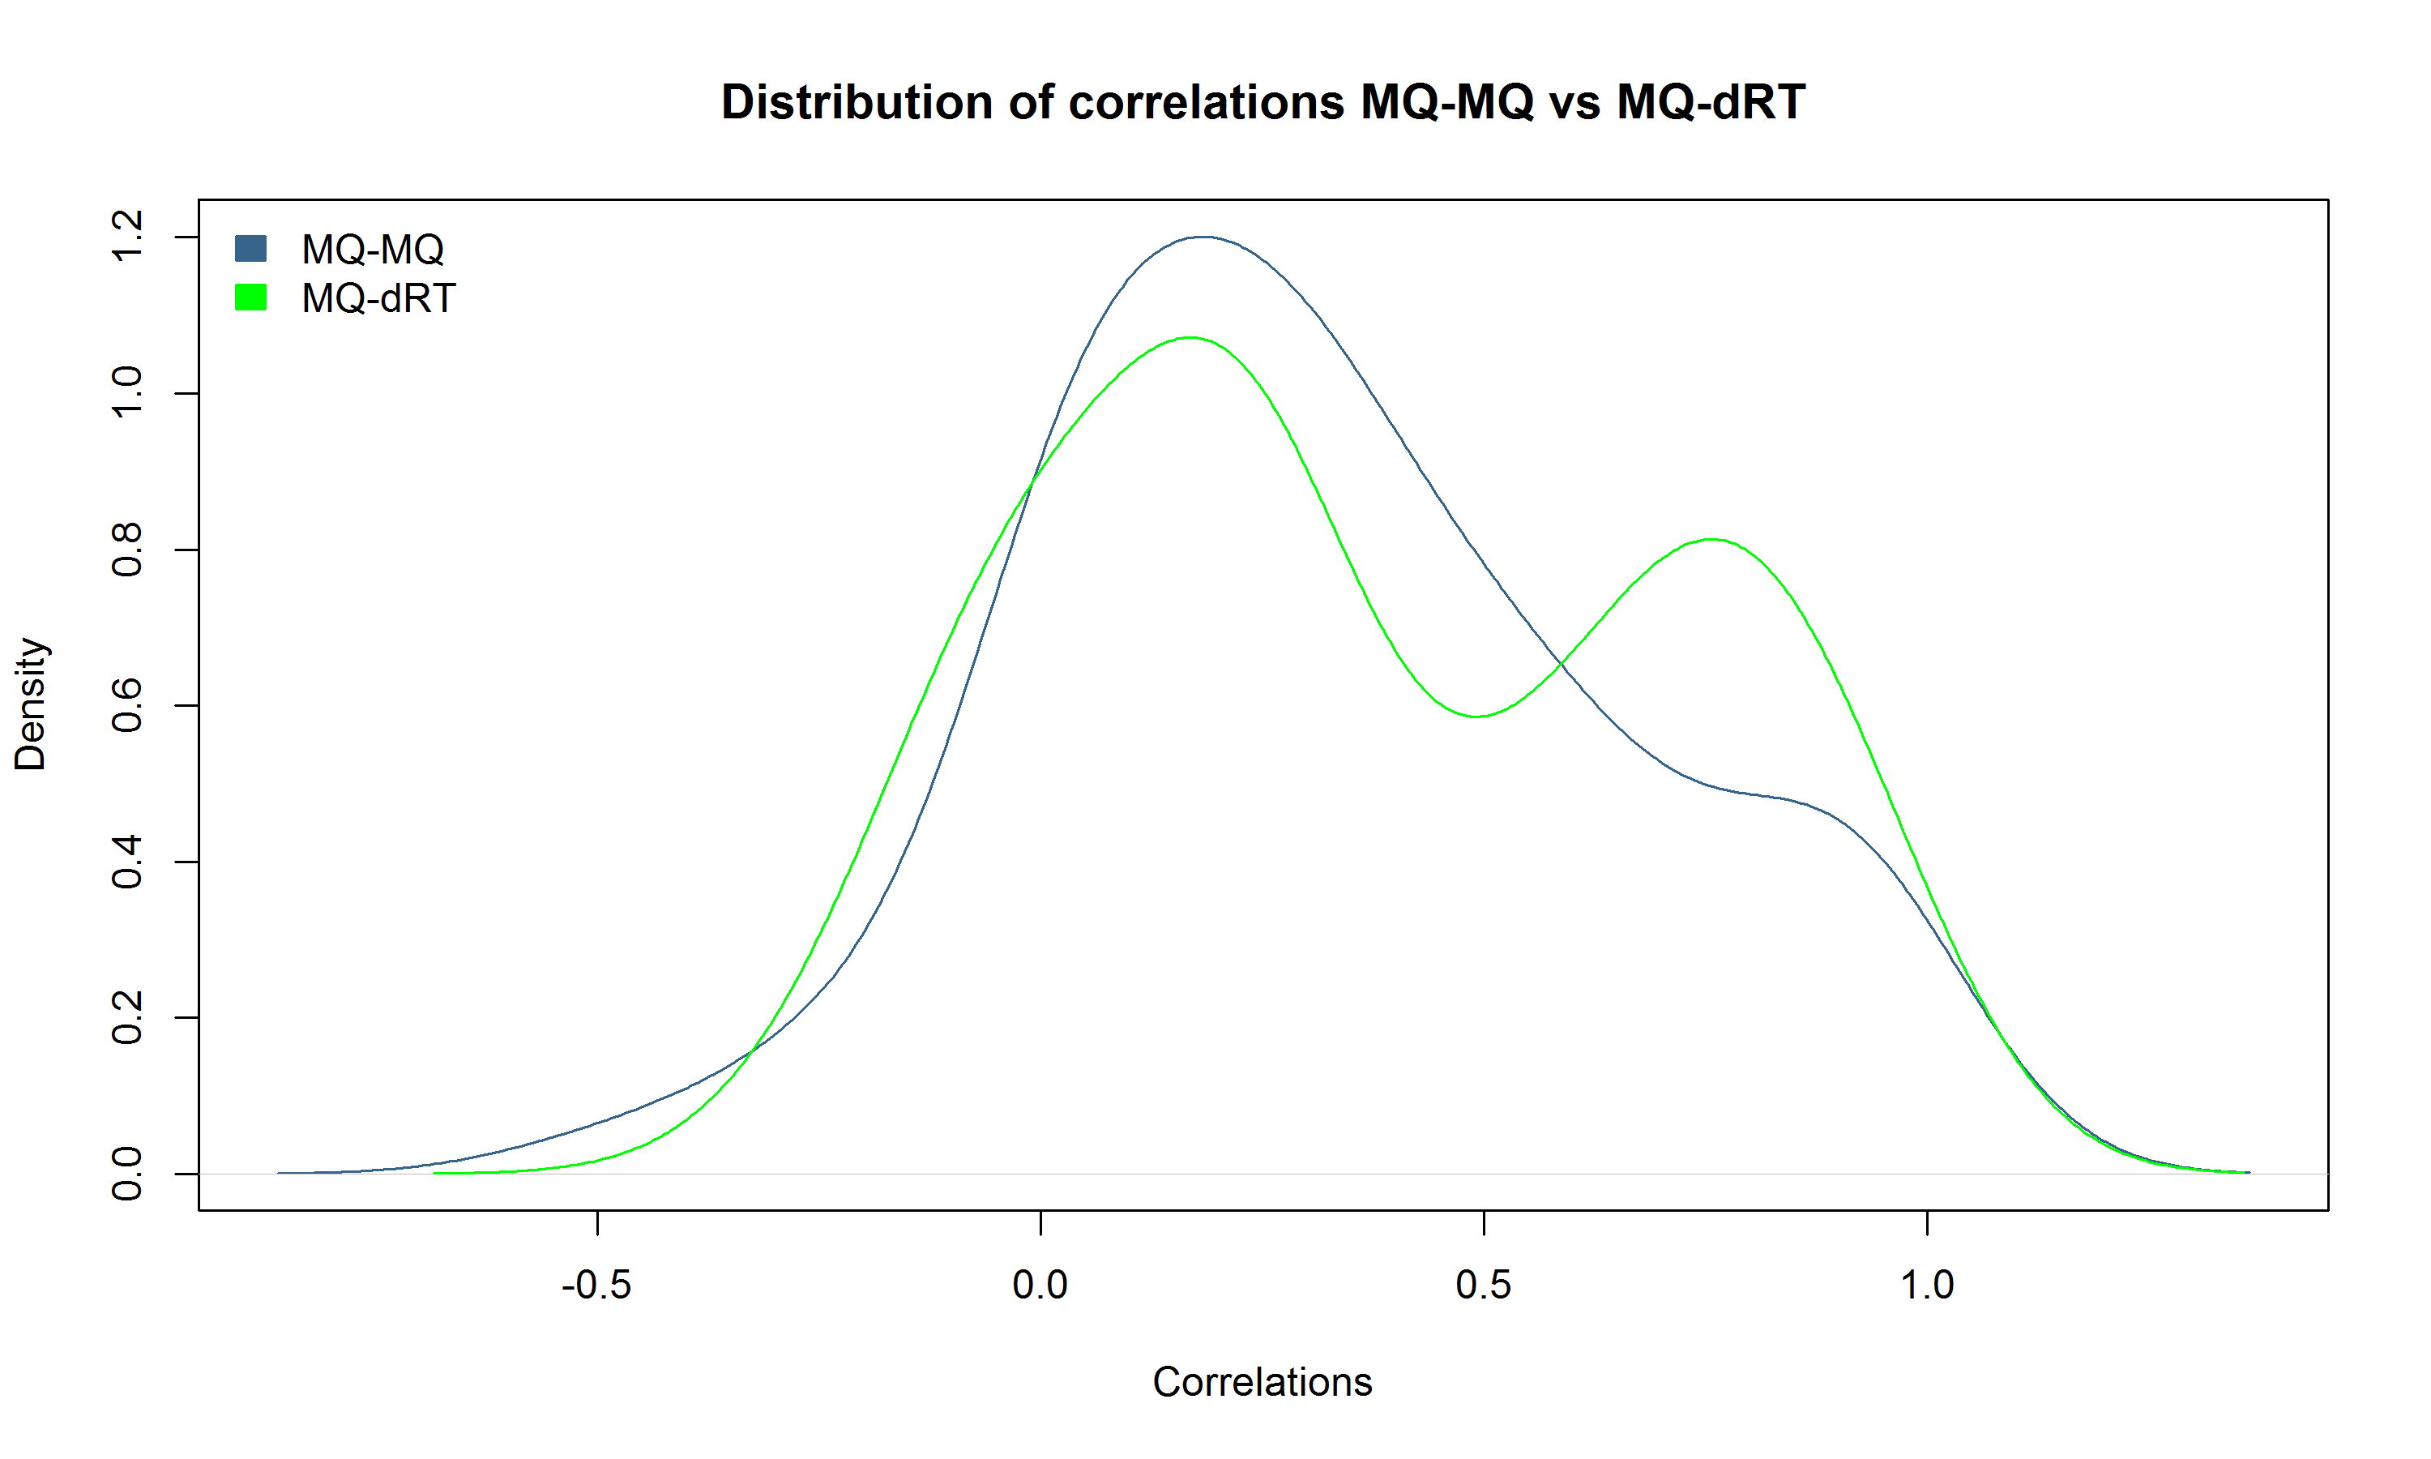


127 N
127 C

Slide 15
Comparing the average of the correlations for:
Max Quant vs. Max Quant → PEP < 0.02
Max Quant vs. dRT updated PEPs → PEP / PEP.updated < 0.02
Channel 0 / Channel 1
trial | mean correlations MQ - MQ | mean correlations MQ - dRT
1 | 0.3276551 | 0.3626784
2 | 0.3657295 | 0.3626784
3 | 0.3622344 | 0.3626784
4 | 0.3841859 | 0.3626784
5 | 0.3375627 | 0.3626784
6 | 0.3735431 | 0.3626784
7 | 0.377827 | 0.3626784
8 | 0.3802886 | 0.3626784
9 | 0.3546417 | 0.3626784
10 | 0.360436 | 0.3626784
Channel 4 / Channel 5
trial | mean correlations MQ - MQ | mean correlations MQ - dRT
1 | 0.329493 | 0.3182408
2 | 0.3541761 | 0.3182408
3 | 0.352055 | 0.3182408
4 | 0.3691091 | 0.3182408
5 | 0.3509342 | 0.3182408
6 | 0.3559165 | 0.3182408
7 | 0.375187 | 0.3182408
8 | 0.301188 | 0.3182408
9 | 0.3177432 | 0.3182408
10 | 0.359455 | 0.3182408

Slide 16
Thank You

